Slide 1

GENETIC ALGORITHMS
CENG 512
OPTIMIZATION ALGORITHMS IN ARTIFICIAL INTELLIGENCE
YASEMİN KILIÇ

Slide 2
OUTLINE
Quick Overview
Biological Background
Basic Structure
Representation (Encoding)
Algorithm
Advantages
Disadvantages
Limitations
Examples
Conclusion

Slide 3
GENETIC ALGORITHMS Quick Overview
Developed: USA in the 1970’s
Early names: J. Holland, K. DeJong, D. Goldberg
Typically applied to:
Discrete optimization
Attributed features:
Not too fast
Good heuristic for combinatorial problems
Special Features:
Traditionally emphasizes combining information from good parents (crossover)
Many variants, e.g., reproduction models, operators

Slide 4
GENETIC ALGORITHMS
GA’s inspired by Darwin’s Theory about evolution.
DARWINIAN SELECTION: From a group of individuals the best will survive
Understanding a GA means understanding the simple, iterative processes that underpin evolutionary change
GA is an algorithm which makes it easy to search a large search space
EXAMPLE: finding largest divisor of a big number
By implementing this Darwinian selection to the problem only the best solutions will remain, thus narrowing the search space.
EVOLUTIONARY COMPUTING – BIOLOGY PERSPECTIVE Origin of species from a common descent and descent of species, as well as their change, multiplication and diversity over time_{[2]}

Slide 5
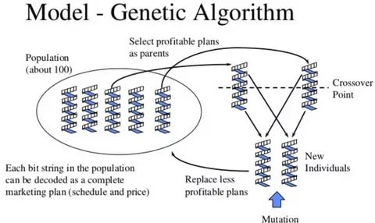
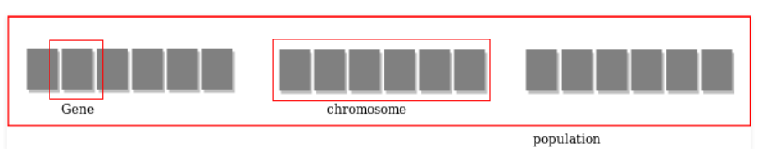
GENETIC ALGORITHMS
A genetic algorithm is a search heuristic that mimics the process of natural evolution used to generate useful solutions to optimization and search problems. _{[2]}
It is frequently used to find optimal or near-optimal solutions to difficult problems which otherwise would take a lifetime to solve.
They are commonly used to generate high-quality solutions for optimization problems and search problems._{[7]}

Slide 6
Optimization is the process of making something better.

Slide 7
BIOLOGICAL BACKGROUND
A set of genes. Chromosome contains the solution in form of genes.
A part of chromosome. A gene contains a part of solution. It determines the solution. E.g. 16743 is a chromosome and 1, 6, 7, 4 and 3 are its genes.
Same as chromosome.
No of individuals present with same length of chromosome.
Fitness is the value assigned to an individual. It is based on how far or close a individual is from the solution. Greater the fitness value better the solution it contains.
Fitness function is a function which shows the ability of an individual to “compete”,
the function that the algorithm is trying to optimize . It is problem specific.
Selecting individuals for creating the next generation.
(Recombination) Genes from parents form in some way the whole new chromosome.
Changing a random gene in an individual.
Chromosome :
Gene :
Individual :
Population :
Fitness :
Fitness
Function :
Selection :
Crossover :
Mutation :

Slide 9
BIOLOGICAL BACKGROUND
It is the value a gene takes for a particular chromosome.
Genotype is the population in the computation space. In the computation space, the solutions are represented in a way which can be easily understood and manipulated using a computing system.
Phenotype is the population in the actual real world solution space in which solutions are represented in a way they are represented in real world situations.
For simple problems, the phenotype and genotype spaces are the same. However, in most of the cases, the phenotype and genotype spaces are different. Decoding is a process of transforming a solution from the genotype to the phenotype space, while encoding is a process of transforming from the phenotype to genotype space.Decoding should be fast as it is carried out repeatedly in a GA during the fitness value calculation.
Allele :
Genotype :
Phenotype :
Decoding
and
Encoding :

Slide 10
GENETIC ALGORITHMS
Holland’s original GA is now known as the simple genetic algorithm (SGA).
Other GAs use different:
Representations
Mutations
Crossovers
Selection mechanisms

Slide 11
BASIC STRUCTURE OF GENETIC ALGORITHM

Slide 12
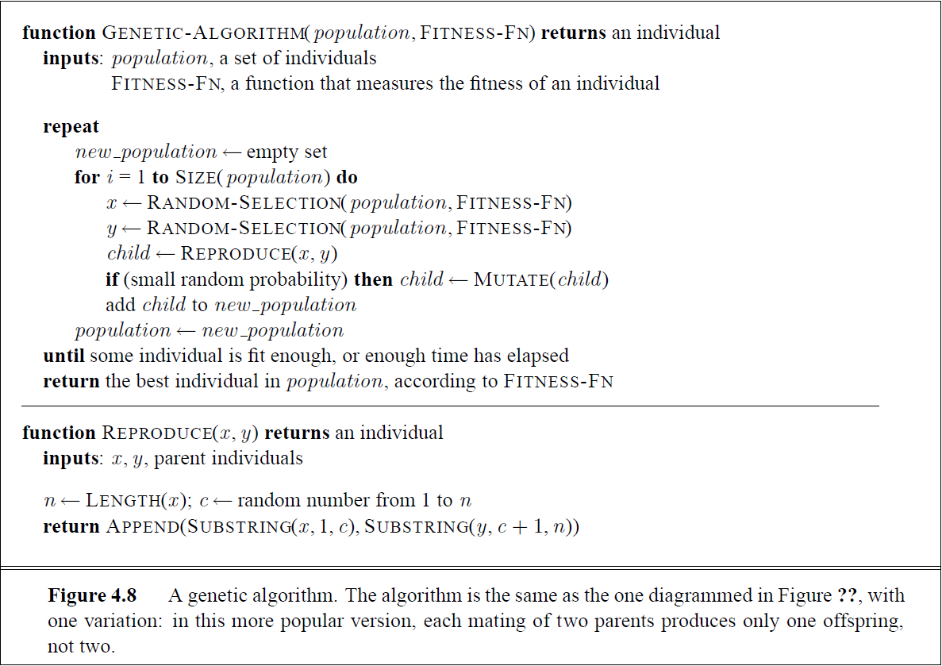
Genetic Algorithm

Slide 13
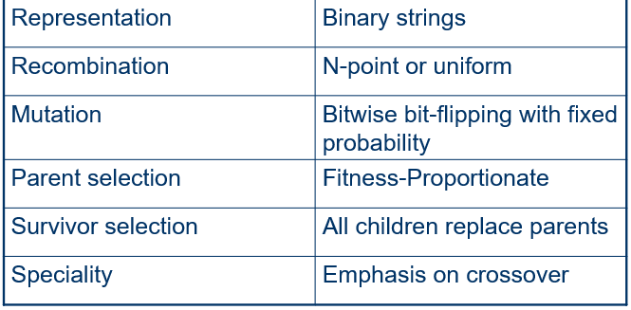

Slide 14

Encoding of chromosomes is the first step in solving the problem and it depends entirely on the problem heavily.
The process of representing the solution in the form of a string of bits that conveys the necessary information._{[7]}
“Coding of the population for evolution process”
Representation
(Encodıng)

Slide 15
Simple GA – Representation (Encoding)
Phenotype space
Genotype space = {0,1}^{L}
Encoding
(representation)
10010001
10010010
010001001
011101001
Decoding
(inverse representation)

Slide 16
Simple GA – Representation (Encoding)
Methods are ;
Gray coding of integers (still binary chromosomes)
Gray coding is a mapping that means that small changes in the genotype cause small changes in the phenotype (unlike binary coding). “Smoother” genotype-phenotype mapping makes life easier for the GA
Nowadays it is generally accepted that it is better to encode numerical variables directly as
Integers
Floating point variables

Slide 17
Simple GA – Integer representations
Some problems naturally have integer variables, e.g. image processing parameters
Others take categorical values from a fixed set e.g. {blue, green, yellow, pink}
N-point / uniform crossover operators work
Extend bit-flipping mutation to make
“creep” i.e. more likely to move to similar value
Random choice (esp. categorical variables)
For ordinal problems, it is hard to know correct range for creep, so often use two mutation operators in tandem

Slide 18
GENOTYPE REPRESENTATION
BINARY REPRESENTATION
REAL VALUED REPRESENTATION

Slide 19
GENOTYPE REPRESENTATION
INTEGER REPRESENTATION
PERMUTATION REPRESENTATION

Slide 20
BINARY ENCODING:
VALUE ENCODİNG
PERMUTATION ENCODING:
Chromosome A 011010110110110101
Chromosome B 101001010100101001
GA – Encoding
Example
Chromosome A 1.235 5.323 0.454 2.321 2.454
Chromosome B (left),(back),(left),(right),(forward)
Example: sort algorithm: important thing is which elements occur before others (order)
Example: Travelling Salesman Problem (TSP) : important thing is which elements occur next to each other (adjacency)
Chromosome A 12345678
Chromosome B 83456127
Notes:
Encoding Methods :
Binary Encoding : Most common methods of encoding. Chromosomes are string of 1s and 0s and each position in the chromosome represents a particular characteristics of the problem.
Permutation Encoding : Useful in ordering such as the Travelling Salesman Problem (TSP). In TSP, every chromosome is a string of numbers, each of which represents a city to be visited.
Value Encoding : Used in problems where complicated values, such as real numbers, are used and where binary encoding would not suffice. Good for some problems, nut often necessary to develop some specific crossover and mutation techniques for these chromosomes.

Slide 21
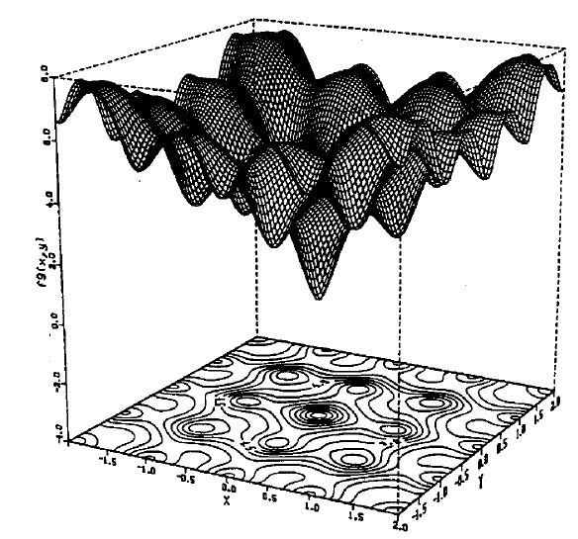
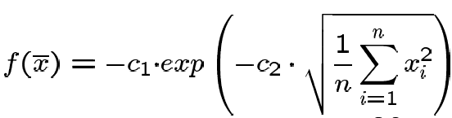
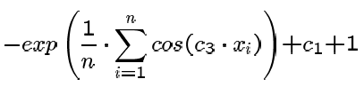
Many problems occur as real valued problems, e.g. continuous parameter optimisation f : ℜ ^{n} → ℜ
Illustration: Ackley’s function (often used in EC)
Real valued problems

Slide 22
z ∈ [x,y] ⊆ ℜ represented by {a₁,…,a_{L}} ∈ {0,1}^{L}
[x,y] → {0,1}^{L} must be invertible (one phenotype per genotype)
Γ: {0,1}^{L} → [x,y] defines the representation
Only 2^{L} values out of infinite are represented
L determines possible maximum precision of solution
High precision → long chromosomes (slow evolution)
Mapping real values on bit strings

Slide 23
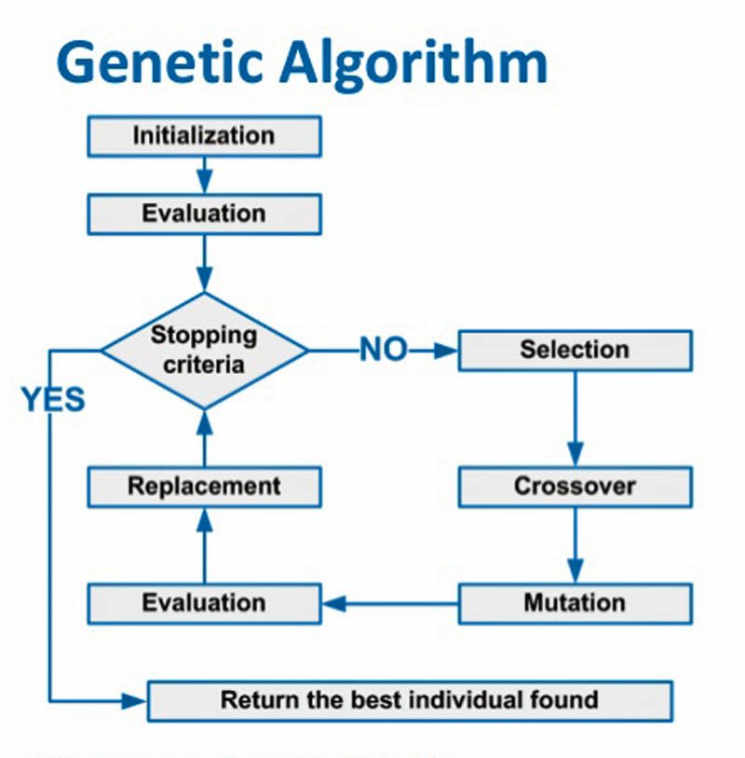

Slide 24
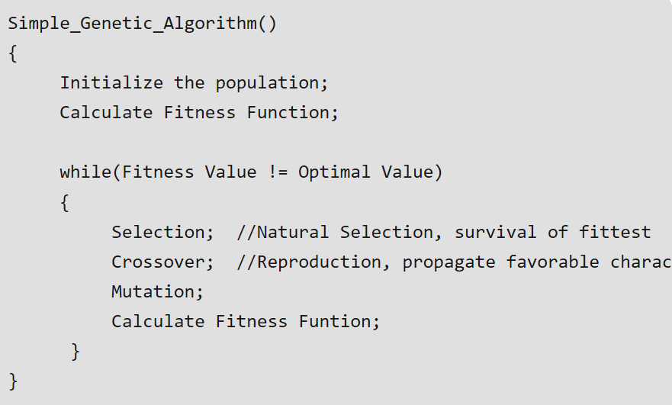
General Algorithm of GA

Slide 25
GENERAL ALGORITHM OF GA
START
Generate initial population.
Assign fitness function to all individuals.
DO UNTIL best solution is found
Select individuals from current generation
Create new offsprings with mutation and/or breeding
Compute new fitness for all individuals
Kill all unfit individuals to give space to new offsprings
Check if best solution is found
LOOP END

Slide 26
Select
Select parents for the mating pool
(size of mating pool = population size)
Shuffle
Shuffle the mating pool
Crossover
For each consecutive pair apply crossover with probability pc , otherwise copy parents
Mutation
For each offspring apply mutation (bit-flip with probability pm independently for each bit)
Replace
Replace the whole population with the resulting offspring
Simple GA - Reproduction Cycle

Slide 27
POPULATION MODEL
STEADY STATE
GENERATIONAL
POPULATION INITIALIZATION
RANDOM INITIALIZATION
HEURISTIC INITIALIZATION

Slide 28
There are many methods how to select the best chromosomes _{[4]}
Fitness-proportionate selection (making an individual's survival probability a function of its fitness score)
Roulette wheel selection (most common)
Stochastic universal sampling
Tournament selection
Truncation selection
Rank selection
Sigma scaling (as Rank Selection, but not too strong in early generations and not too weak once the population has stabilised and fitness differences are smaller)
Elitism (When cross-over or mutation results in offspring that are weaker than the parents. It involves copying a small propotion of the fittest candidates, unchanged, into the next generation)
Chromosomes are selected from the population to be parents to crossover. _{[2]}
Selection
Notes:
Elitism
Sometimes good candidates can be lost when cross-over or mutation results in offspring that are weaker than the parents. Often the EA will re-discover these lost improvements in a subsequent generation but there is no guarantee. To combat this we can use a feature known as elitism. Elitism involves copying a small propotion of the fittest candidates, unchanged, into the next generation. This can sometimes have a dramatic impact on performance by ensuring that the EA does not waste time re-discovering previously discarded partial solutions. Candidate solutions that are preserved unchanged through elitism remain eligible for selection as parents when breeding the remainder of the next generation.
Tip
The Watchmaker Framework supports elitism via the second parameter to the evolve method of an EvolutionEngine. This elite count is the number of candidates in a generation that should be copied unchanged from the previous generation, rather than created via evolution. Collectively these candidates are the elite. So for a population size of 100, setting the elite count to 5 will result in the fittest 5% of each generation being copied, without modification, into the next generation.

Slide 29
1/6 = 17%
fitness(A) = 3
B
A
C
fitness(B) = 1
3/6 = 50%
2/6 = 33%
fitness(C) = 2
GA - Operators:
Selection
Main idea: better individuals get higher chance
Chances proportional to fitness
Implementation: roulette wheel technique
Assign to each individual a part of the roulette wheel
Spin the wheel n times to select n individuals

Slide 30
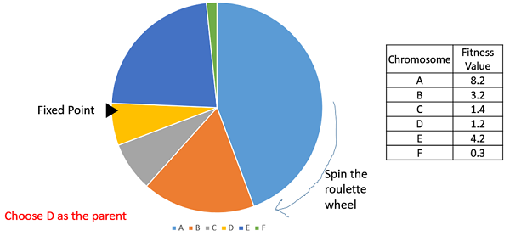
FITNESS-PROPORTIONATE SELECTION
A - ROULETTE WHEEL SELECTION
In a roulette wheel selection, the circular wheel is divided as in figure. A fixed point is chosen on the wheel circumference as shown and the wheel is rotated. The region of the wheel which comes in front of the fixed point is chosen as the parent. For the second parent, the same process is repeated.
Parents are selected according to their fitness. it is possible for an individual to be a parent multiple times.
Darwinian survival of the fittest
By itself, pick best
Notes:
Kromozom uygunluklarına göre, daha iyi kromozomlar daha fazla seçilme sansına sahip olanlardır.
%90 ve üzeri durumlarda verimlilik azalır. Sıralı Seçim uygulanır.(En kötü kromozoma 1 ekle, diğerini 2, …)

Slide 31
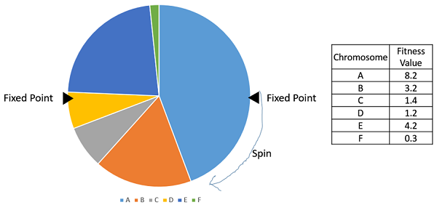
FITNESS-PROPORTIONATE SELECTION
B – STOCHASTIC UNIVERSAL SAMPLING
Stochastic Universal Sampling is an elaborately-named variation of roulette wheel selection.
It ensures that the observed selection frequencies of each individual are in line with the expected frequencies.
So if we have an individual that occupies 4.5% of the wheel and we select 100 individuals, we would expect on average for that individual to be selected between four and five times. Stochastic Universal Sampling guarantees this. Standard roulette wheel selection does not make this guarantee.
Notes:
Stochastic Universal Sampling is quite similar to Roulette wheel selection, however instead of having just one fixed point, we have multiple fixed points as shown in the following image. Therefore, all the parents are chosen in just one spin of the wheel. Also, such a setup encourages the highly fit individuals to be chosen at least once.

Slide 32
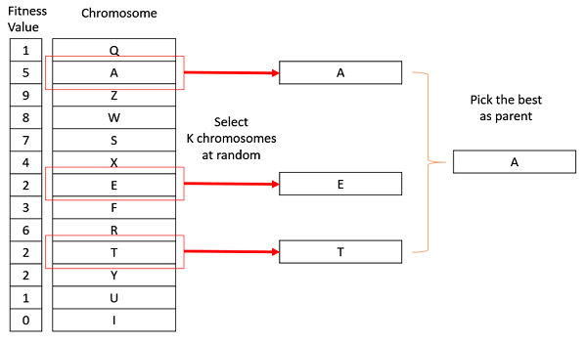
II. TOURNAMENT
In K-Way tournament selection, we select K individuals from the population at random and select the best out of these to become a parent. The same process is repeated for selecting the next parent. Tournament Selection is also extremely popular in literature as it can even work with negative fitness values._{[6]}
Only the fittest candidate amongst those selected candidates is chosen and is passed on to the next generation.
Ga’s are able to identify optimal or near-optimal solutions over a wide range of selection pressures.
Tournament selection also works for negative fitness values._{[5]}
Notes:
Tournament Selection (GA)
Tournament Selection is a Selection Strategy used for selecting the fittest candidates from the current generation in a Genetic Algorithm. These selected candidates are then passed on to the next generation. In a K-way tournament selection, we select k-individuals and run a tournament among them. Only the fittest candidate amongst those selected candidates is chosen and is passed on to the next generation. In this way many such tournaments take place and we have our final selection of candidates who move on to the next generation. It also has a parameter called the selection pressure which is a probabilistic measure of a candidate’s likelihood of participation in a tournament. If the tournament size is larger, weak candidates have a smaller chance of getting selected as it has to compete with a stronger candidate. The selection pressure parameter determines the rate of convergence of the GA. More the selection pressure more will be the Convergence rate. GAs are able to identify optimal or near-optimal solutions over a wide range of selection pressures. Tournament Selection also works for negative fitness values.
Algorithm -- 1.Select k individuals from the population and perform a tournament amongst them 2.Select the best individual from the k individuals 3. Repeat process 1 and 2 until you have the desired amount of population Let us have a 3-way tournament selection and our desired population size is 6 and the initial population with their fitness scores is [1, 2, 3, 4, 5, 6]. Our first tournament will look something like this (see the diagram) and the winner candidate with fitness value 6 moves on to the next generation. -----resim---- After the first tournament we have our selected population as [6]. After a few such tournaments, we might have a selected population as [6, 6, 6, 5, 4, 3]. It might even be [6, 6, 5, 4, 3, 2]. Hence the fittest candidate is more likely to be selected for the next generation. If the best candidate is selected with probability p then the next best candidate will be selected with a probability of p*(1-p) and the next one with p*(1-p)² and so on …

Slide 33
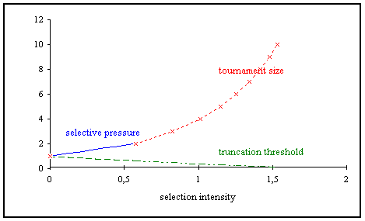
III. TRUNCATION
Truncation selection is the simplest and arguably least useful selection strategy.
Truncation selection simply retains the fittest x% of the population. These fittest individuals are duplicated so that the population size is maintained.
For example, we might select the fittest 25% from a population of 100 individuals. In this case we would create four copies of each of the 25 candidates in order to maintain a population of 100 individuals.
This is an easy selection strategy to implement but it can result in premature convergence as less fit candidates are ruthlessly culled without being given the opportunity to evolve into something better. Nevertheless, truncation selection can be an effective strategy for certain problems.

Slide 34
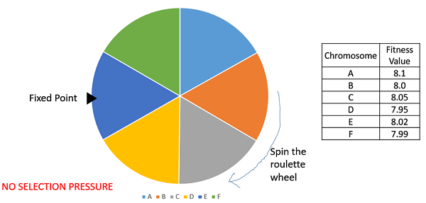
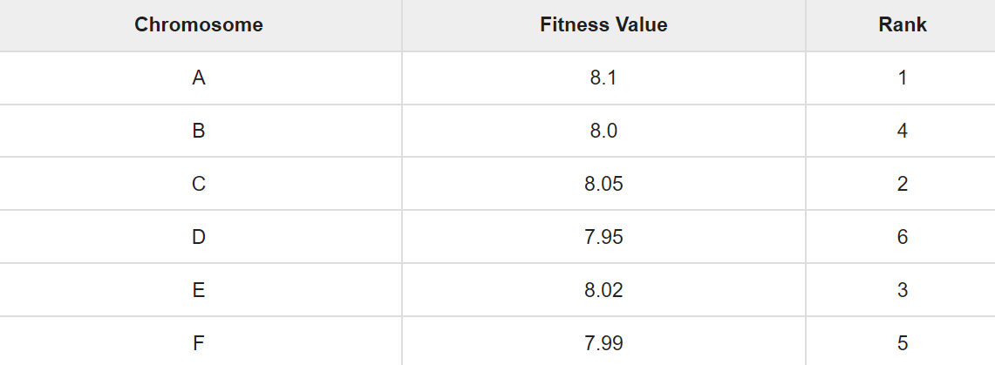
IV. RANK SELECTİON
Rank Selection is similar to fitness-proportionate selection except that selection probability is proportional to relative fitness rather than absolute fitness. _{[5]}
It also works with negative fitness values and is mostly used when the individuals in the population have very close fitness values_{[6]}
It will tend to avoid premature convergence by tempering selection pressure for large fitness differentials that occur in early generations.
Conversely, by amplifying small fitness differences in later generations, selection pressure is increased compared to alternative selection strategies.
The selection of the parents depends on the rank of each individual and not the fitness. The higher ranked individuals are preferred more than the lower ranked ones.

Slide 35
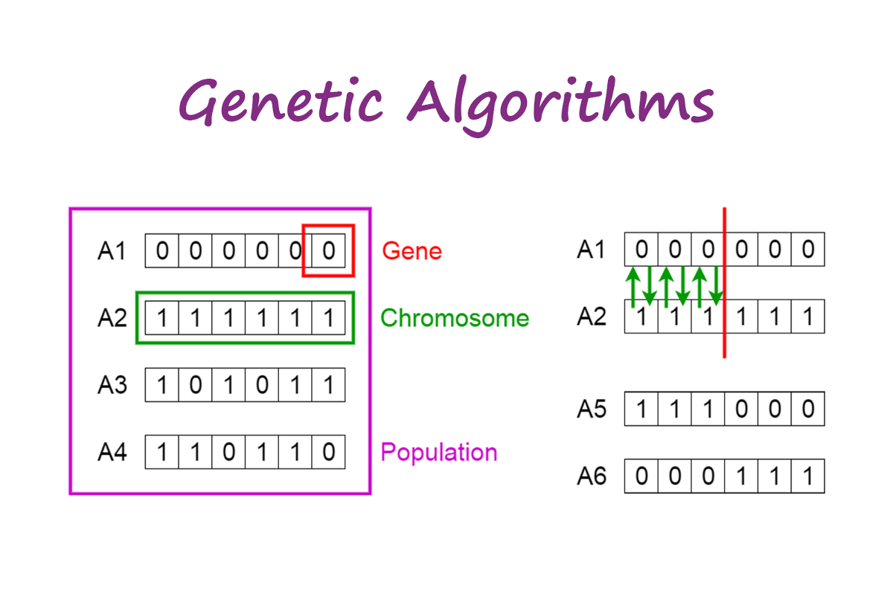
One parent is selected and one or more offsprings
are produced using the genetic material of the parents
One Point Crossover
CROSSOVER

Slide 36
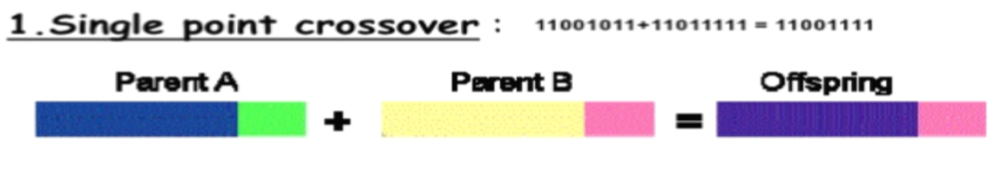
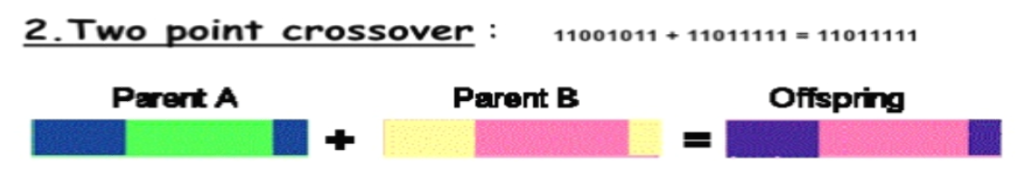
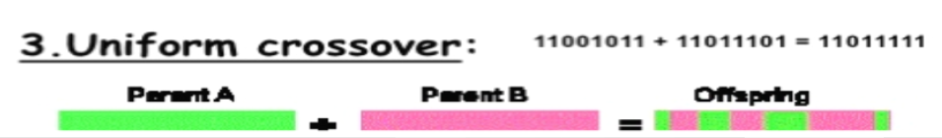
RECOMBINATION (CROSSOVER)
Genetic recombination is crossover to find the optimum solution._{[2]}
There are many ways how to do crossover and mutation.
Single Point Crossover - in this case one crossover point is selected, binary string from beginning of chromosome to the crossover point is copied from one parent, and the rest is copied from the second parent 11001011 + 11011111 = 11001111
Two Point Crossover here two crossover points are selected, binary string from beginning of chromosome to the first crossover point is copied from one parent, the part from the first to the second crossover point is copied from the second parent and the rest is copied from the first parent 11001011 + 11011111 = 11011111
Uniform Crossover in this method bits are randomly copied from the first or from the second parent 11001011 + 11011101 = 11011111

Slide 37
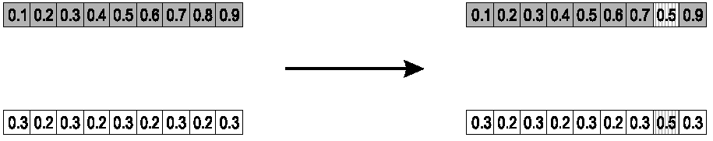
Parents: ⟨x₁,…,x_{n} ⟩ and ⟨y₁,…,y_{n}⟩
Pick a single gene (k) at random,
child₁ is:
reverse for other child. e.g. with α = 0.5
GA – Operators:
Single arithmetic crossover

Slide 38
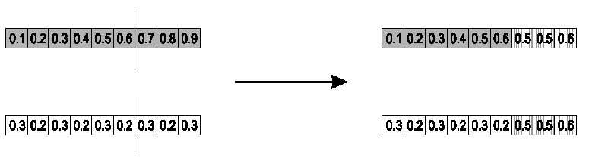
Parents: ⟨x₁,…,x_{n} ⟩ and ⟨y₁,…,y_{n}⟩
Pick a single gene (k) at random,
child₁ is:
reverse for other child. e.g. with α = 0.5
GA – Operators:
Simple arithmetic crossover

Slide 39
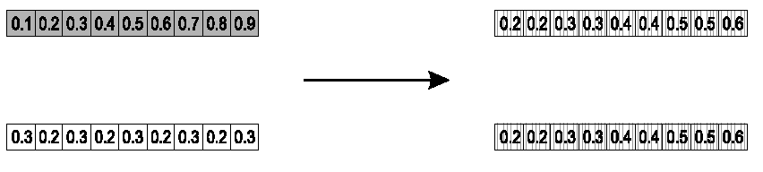
Most commonly used
Parents: ⟨x₁,…,x_{n} ⟩ and ⟨y₁,…,y_{n}⟩
child₁ is:
reverse for other child. e.g. with α = 0.5
GA – Operators:
Whole arithmetic crossover

Slide 40
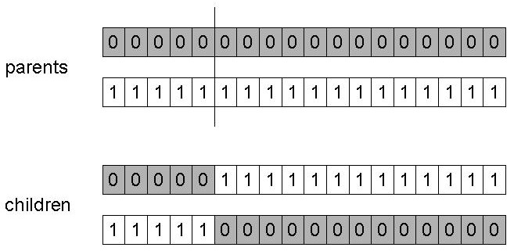
GA – Operators:
1 Point Crossover
Choose a random point on the two parents
Split parents at this crossover point
Create children by exchanging tails
P_{c} typically in range (0.6, 0.9)

Slide 41
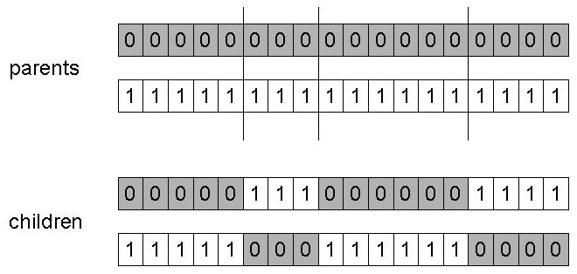
GA – Operators:
N Point Crossover
Choose n random crossover points
Split along those points
Glue parts, alternating between parents
Generalisation of 1 point (still some positional bias)

Slide 42
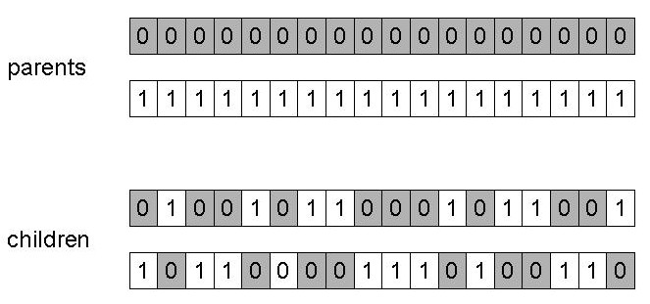
GA – Operators:
Uniform Crossover
Assign 'heads' to one parent, 'tails' to the other
Flip a coin for each gene of the first child
Make an inverse copy of the gene for the second child
Inheritance is independent of position

Slide 43
One Point Crossover
Multi Point Crossover
Uniform Crossover

Slide 44
Discrete:
each allele value in offspring z comes from one of its parents (x,y) with equal probability: z_{i} = x_{i} or y_{i}
Could use n-point or uniform
Intermediate
exploits idea of creating children “between” parents (hence a.k.a. arithmetic recombination)
z_{i} = α x_{i} + (1 - α) y_{i} where α : 0 ≤ α ≤ 1.
The parameter α can be:
constant: uniform arithmetical crossover
variable (e.g. depend on the age of the population)
picked at random every time
Crossover operators for real valued GAs

Slide 45
MUTATION
Mutation is a genetic operator used to maintain genetic diversity from one generation of a population to the next. It is similar to biological mutation _{[4]}
The purpose of mutation in GAs is preserving and introducing diversity. Mutation should allow the algorithm to avoid local minima by preventing the population of chromosomes from becoming too similar to each other._{[4]}

Slide 46
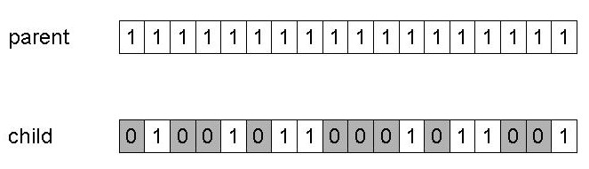
GA - Operators: Mutation
Alter each gene independently with a probability p_{m}
p_{m} is called the mutation rate
Typically between 1/pop_size and 1/ chromosome_length

Slide 47
A common method of implementing the mutation operator involves generating a random variable for each bit in a sequence.
This random variable tells whether or not a particular bit will be modified.
This mutation procedure, based on the biological point mutation, is called single point mutation.
GA – Operators:
Single point mutation

Slide 48
General scheme of floating point mutations)
Uniform mutation:
Analogous to bit-flipping (binary) or random resetting (integers)
GA – Operators:
Floating Point Mutation 1
A common method of implementing the mutation operator
are inversion and floating point mutation. When the gene encoding is restrictive as in permutation problems, mutations are swaps, inversions and scrambles.

Slide 49
Bit Flip Mutation
Random Resetting
-Swap Mutation
Scramble Mutation
Inversion Mutation
GA – Operators:
Other mutations

Slide 50
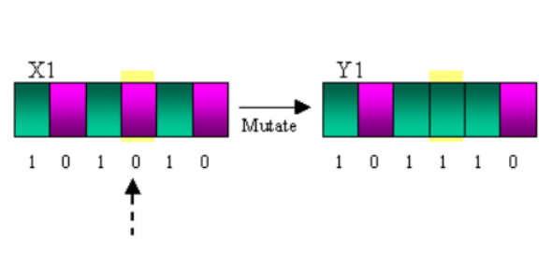
Mutation is random alteration of a string
Change a gene, small movement in the neighbourhood
By itself, a random walk
Example 1 =>
Before: 10001001110010010
After: 10000001110110010
GA – Mutation
Example

Slide 51
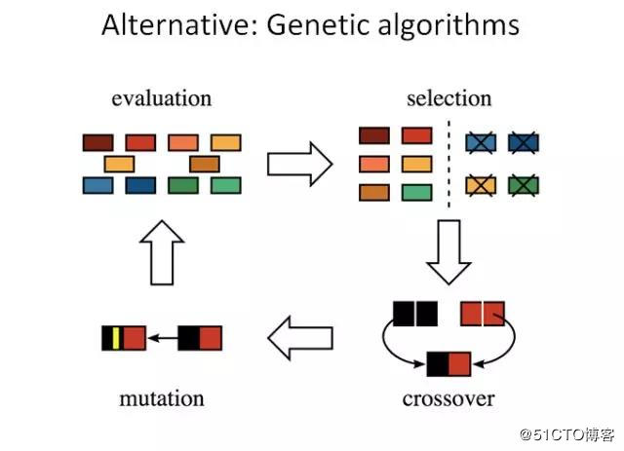

Slide 52
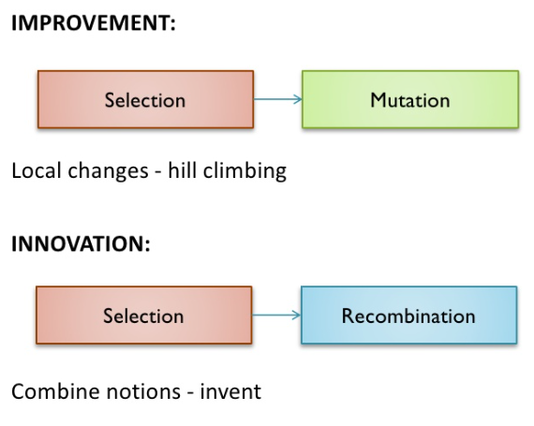
Improvement / Innovation
Crossover and mutation are two basic operators of GA.
Performance of GA very depend on them.
Type and implementation of operators depends on encoding and also on a problem.

Slide 53
Simple problem: max x² over {0,1,…,31}
GA approach:
Representation: binary code, e.g. 01101 ↔ 13
Population size: 4
1-point crossover, bitwise mutation
Roulette wheel selection
Random initialization
We show one generational cycle done by hand
GA – Example

Slide 54
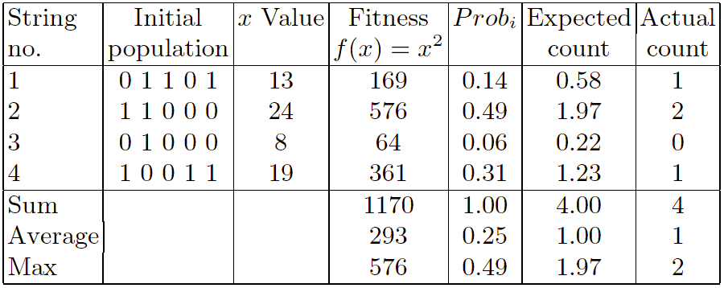
GA – Example
x² : Selection

Slide 55
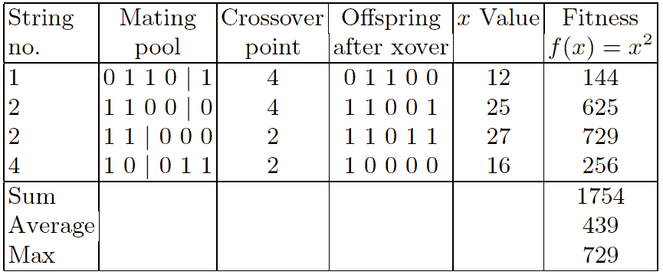
GA – Example
x² : Crossover

Slide 56
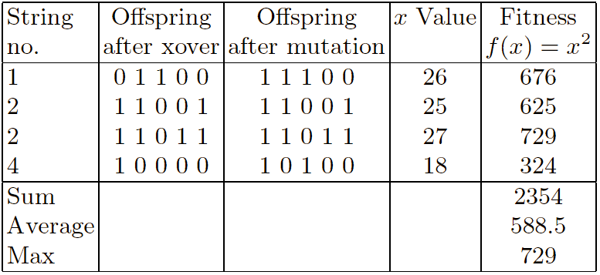
GA – Example
x² : Mutation

Slide 57
Crossover OR mutation?
Decade long debate: which one is better / necessary / main-background
Answer (at least, rather wide agreement):
it depends on the problem, but
in general, it is good to have both
both have another role
mutation-only-EA is possible, xover-only-EA would not work

Slide 58
Exploration: Discovering promising areas in the search space, i.e. gaining information on the problem
Exploitation: Optimising within a promising area, i.e. using information
There is co-operation AND competition between them
Crossover is explorative, it makes a big jump to an area somewhere “in between” two (parent) areas
Mutation is exploitative, it creates random small diversions, thereby staying near (in the area of ) the parent
Crossover OR mutation?

Slide 59
Only crossover can combine information from two parents
Only mutation can introduce new information (alleles)
Crossover does not change the allele frequencies of the population (thought experiment: 50% 0’s on first bit in the population, ?% after performing n crossovers)
To hit the optimum you often need a ‘lucky’ mutation
Crossover OR mutation?

Slide 60
GA- SURVIVOR SELECTION
Age Based Selection

Slide 61
GA- SURVIVOR SELECTION
Fitness Based Selection

Slide 62
GA- Termination Condition
When there has been no improvement in the population for X iterations.
When we reach an absolute number of generations.
When the objective function value has reached a certain pre-defined value

Slide 63
Advantages of GA
--Where there are large solutions to the problem but we have to find the best one.
--Easy to understand
--Always an answer; can gets better with time
--Less time required for some special applications
--Genetic Algorithms are intrinsically parallel.
--Inherently parallel; easily distributed
Chances of getting optimal solution are more
- best moves in chess
- mathematical problems
- financial problems

Slide 64
Disadvantages of GA
GAs are very slow.
They cannot always find the exact solution but they can find its best solution.

Slide 65
Limitations of GA
The performance of a GA depends highly on the method used to encode
candidate solutions into chromosomes:
Fitness function
Crossover rate, (80%-95% )
Mutation rate, (0.5%-1% )
Population Size,
The number of iterations

Slide 66
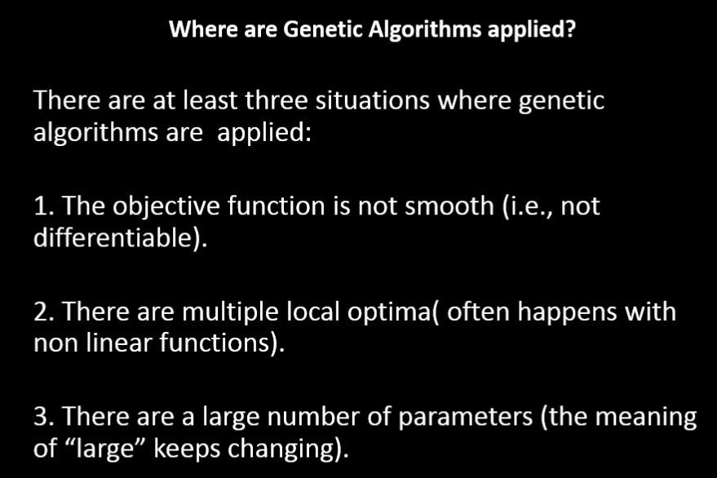

Slide 67
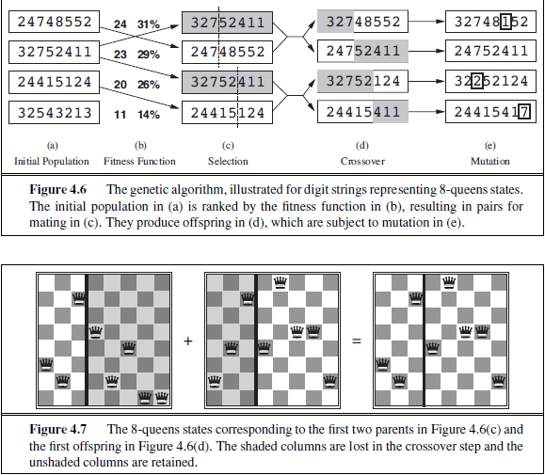

Slide 68
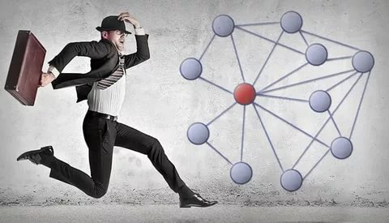
Example
The travelling salesman problem
Find a tour of given set of cities so that:
each city is visited only once
the total distance travelled is minimized

Slide 69
TSP – GA Process
First, create a group of many random tours in what is called a population.
This algorithm uses a greedy initial population that gives preference to linking cities that are close to each other.
Second, pick 2 of the better (shorter) tours parents in the population and combine them to make 2 new child tours. Hopefully, these children tour will be better than either parent.
A small percentage of the time, the child tours are mutated. This is done to prevent all tours in the population from looking identical.
The new child tours are inserted into the population replacing two of the longer tours. The size of the population remains the same.
New children tours are repeatedly created until the desired goal is reached.
Prosses: TSP Example

Slide 70
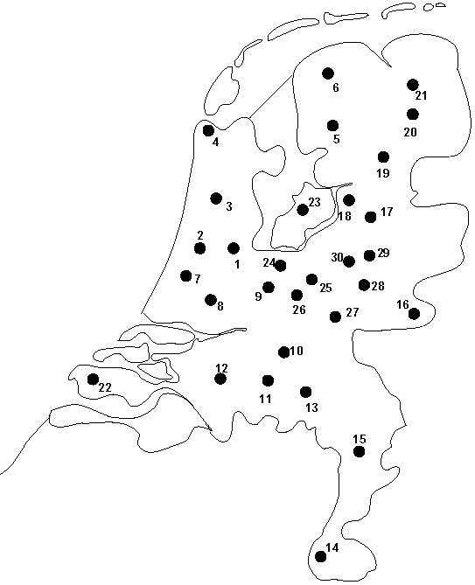
Problem:
Given n cities
Find a complete tour with minimal length
Encoding:
Label the cities 1, 2, … , n
One complete tour is one permutation (e.g. for n =4 [1,2,3,4], [3,4,2,1] are OK)
Search space is BIG:
for 30 cities there are 30! ≈ 10³² possible tours
Permutation representation : TSP Example

Slide 71
TSP - Coding For 8 Cities
Encoding using permutation encoding
1- Chennai 2- Trichy 3- Thanjavur 4- Madurai
5- Bangalore 6- Hyderabad 7- Coimbatore 8- Cochin
City Route 1- ...
City Route 2- ...
......
CROSSOVER:
MUTATION:
Permutation Encoding Crossover: TSP Example
12347856
65872134
12347856
31246587
12346587
12346587
12846537

Slide 72
Pick two allele values at random
Move the second to follow the first, shifting the rest along to accommodate
Note that this preserves most of the order and the adjacency information
Mutation operators for permutations : TSP Example

Slide 73
Pick two alleles at random and swap their positions
Preserves most of adjacency information (4 links broken), disrupts order more
Swap Mutation for permutations : TSP Example

Slide 74
Pick two alleles at random and then invert the substring between them.
Preserves most adjacency information (only breaks two links) but disruptive of order information
Inversion Mutation for permutations : TSP Example

Slide 75
Pick a subset of genes at random
Randomly rearrange the alleles in those positions
(note subset does not have to be contiguous)
Scramble Mutation for permutations : TSP Example

Slide 76
“Normal” crossover operators will often lead to inadmissible solutions
Many specialised operators have been devised which focus on combining order or adjacency information from the two parents
Scramble Mutation for permutations : TSP Example
1 2 3 4 5
1 2 3 2 1
5 4 3 2 1
5 4 3 4 5

Slide 77
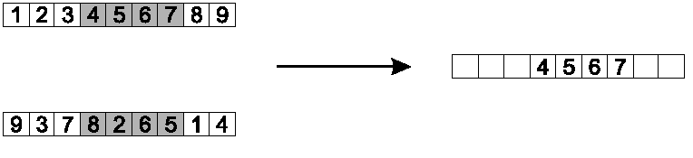
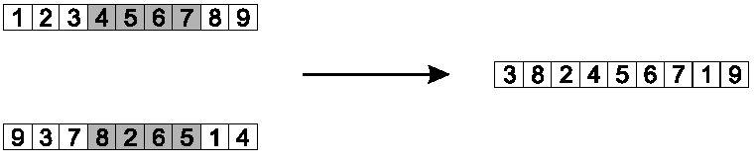
Copy randomly selected set from first parent
Copy rest from second parent in order 1,9,3,8,2
Order 1 crossover : TSP Example
Notes:
Idea is to preserve relative order that elements occur
Informal procedure:
1. Choose an arbitrary part from the first parent
2. Copy this part to the first child
3. Copy the numbers that are not in the first part, to the first child:
starting right from cut point of the copied part,
using the order of the second parent
and wrapping around at the end
4. Analogous for the second child, with parent roles reversed

Slide 78
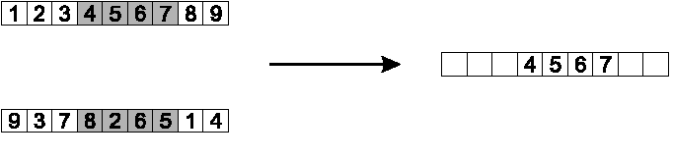
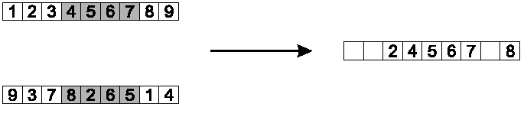
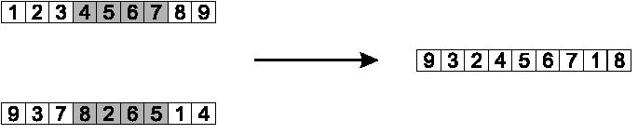
Step 1
Step 2
Step 3
PMX crossover : TSP Example
Notes:
Informal procedure for parents P1 and P2:
Choose random segment and copy it from P1
Starting from the first crossover point look for elements in that segment of P2 that have not been copied
For each of these i look in the offspring to see what element j has been copied in its place from P1
Place i into the position occupied j in P2, since we know that we will not be putting j there (as is already in offspring)
If the place occupied by j in P2 has already been filled in the offspring k, put i in the position occupied by k in P2
Having dealt with the elements from the crossover segment, the rest of the offspring can be filled from P2.
Second child is created analogously

Slide 79
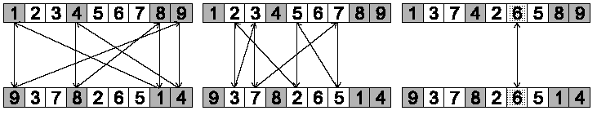
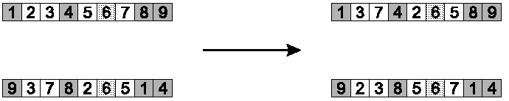
Step 1: identify cycles
Step 2: copy alternate cycles into offspring
Cycle crossover : TSP Example
Notes:
Basic idea:
Each allele comes from one parent together with its position.
Informal procedure:
1. Make a cycle of alleles from P1 in the following way.
(a) Start with the first allele of P1.
(b) Look at the allele at the same position in P2.
(c) Go to the position with the same allele in P1.
(d) Add this allele to the cycle.
(e) Repeat step b through d until you arrive at the first allele of P1.
2. Put the alleles of the cycle in the first child on the positions they have in the first parent.
3. Take next cycle from second parent

Slide 80
The two complex issues with using a Genetic Algorithm to solve the Traveling Salesman Problem are the encoding of the tour and the crossover algorithm that is used to combine the two parent tours to make the child tours.
In this example, the crossover point is between the 3rd and 4th item in the list. To create the children, every item in the parent's sequence after the crossover point is swapped.
Parent 1
Parent 2
Child 1
Child 1
What is the issue here ???
We get invalid sequences as children
TSP Issues
F A B | E C G D
D E A | C G B F
F A B |
C G B F
D E A |
E C G D

Slide 81
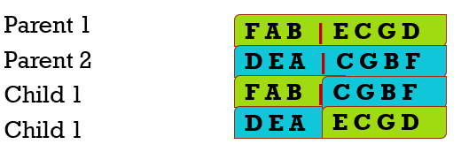
The encoding cannot simply be the list of cities in the order they are travelled.
Other encoding methods have been created that solve the crossover problem.
Although these methods will not create invalid tours, they do not take into account the fact that the tour "A B C D E F G" is the same as "G F E D C B A".
To solve the problem properly the crossover algorithm will have to get much more complicated.
TSP Issues

Slide 82
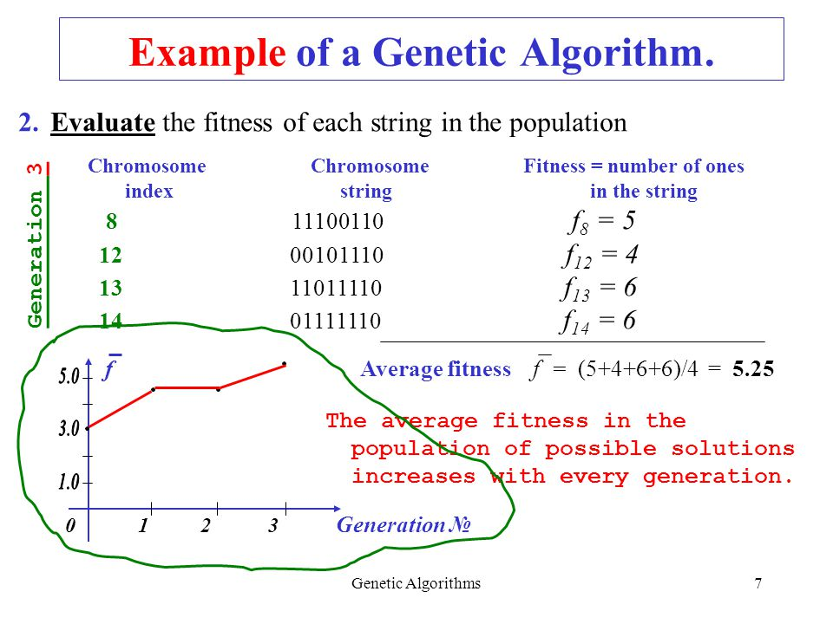

Slide 83
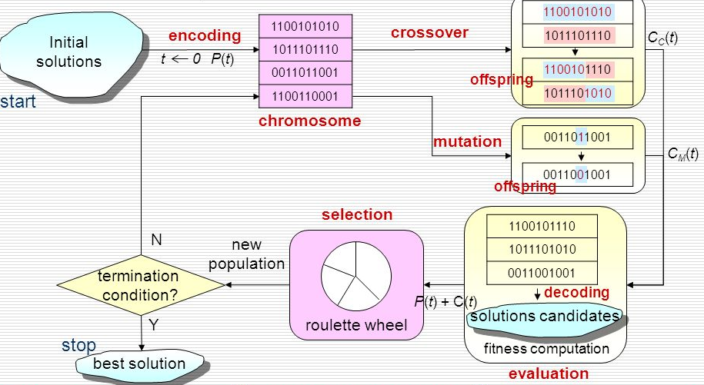

Slide 84
Conclusion
Genetic algorithms are rich in application across a large and growing number of disciplines.
Genetic Algorithms are used in Optimization and in Classification in Data Mining
Genetic algorithm has changed the way we do computer programming.

Slide 85
Referances
,
[1] Tom Mitchell, Machine Learning, Mc-Graw Hill, 1997
[2] Harsh Bhasin, Surbhi Bhatia, ‘Application of Genetic Algorithms in Machine learning’, International Journal of Computer Science and Information Technologies
[3] Karthik Sankar, ‘Presentation on Introduction to Genetic Algorithms and use of GA in Classification Problem of Data Mining’
[4] S. Thrun. Learning to Play the Game of Chess. In G. Tesauro, D. Touretzky, and T. Leen, editors, Advances in Neural Information Processing Systems (NIPS) 7, Cambridge, MA, 1995. MIT Press
[5] Tournament Selection (GA), https://www.geeksforgeeks.org/tournament-selection-ga
[6] https://www.tutorialspoint.com/genetic_algorithms/genetic_algorithms_parent_selection.htm
[7] Avik_Dutta, ‘Encoding Methods in Genetic Algorithm’
[8] Jenna Carr,May 16, An Introduction to Genetic Algorithms, 2014

